Slide 1
Measure Permittivity of Non-flat Soil Using Machine Learning

Slide 2
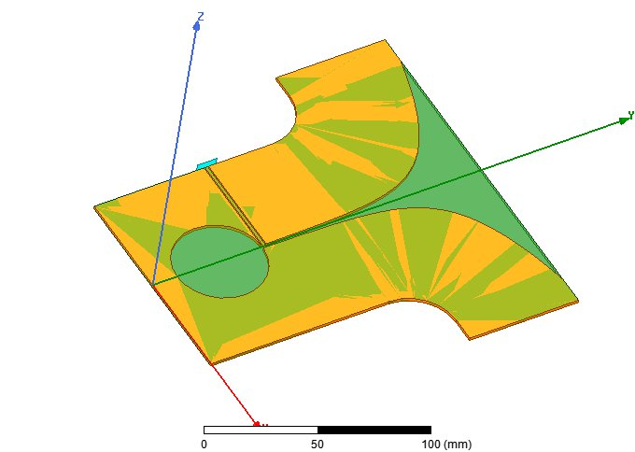
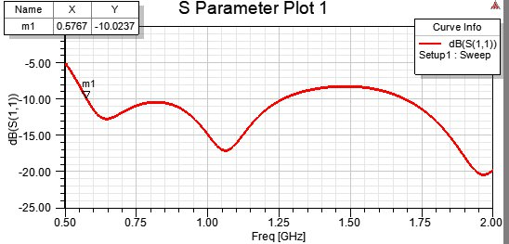
Antenna
Vivaldi antenna is chosen as it is wideband, directive, easy to feed and cheap to build.
Total size: 170mm x 172 mm
The antenna is operating from about 0.6 GHz to more than 2 GHz. The frequency range for the experiment is chosen as from 0.6 GHz to 1 GHz as the permittivity of the soil is approximately constant in this range (to be verified with Alex)

Slide 3
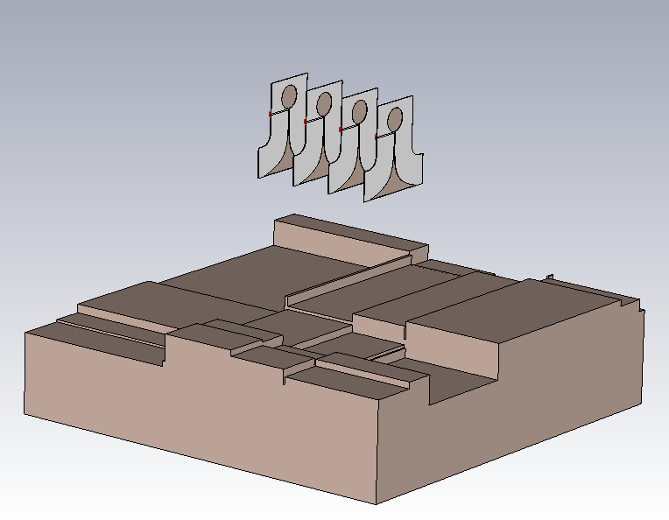
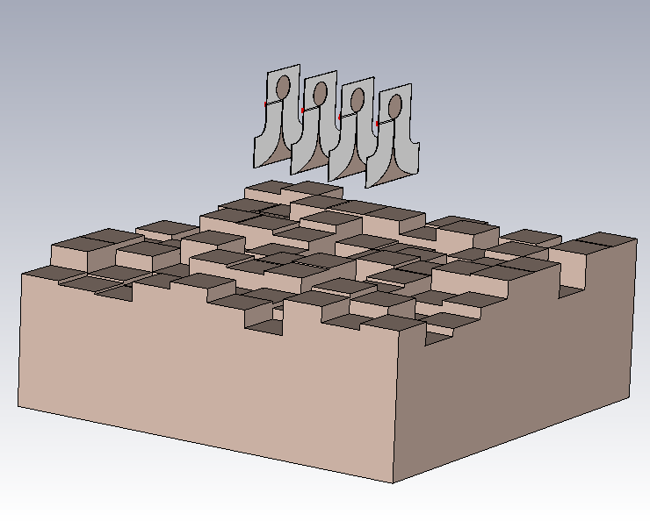
Simulation set up
4 antennas are used
Soils are simulated with random permittivity (ranging from 3 to 40) and random surface.
(Note that 3 corresponds to 0% of water and 78 corresponds to 100% of water)
The distance between the antenna and the soil also varies

Slide 4
Machine Learning
Large amount of data is collected with random soil shape and permittivity (about 1000 samples).
These data are used to train the neural network to predict the correct permittivity of the soil
The optimized parameters of neural network are then verified with different set of data

Slide 5
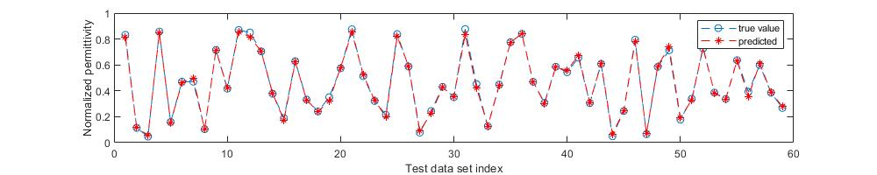
Machine Learning
The results show a great potential. Neural network can predict the permittivity very accurately.
This type of results can be obtained with only two antennas.
Nevertheless, the more antennas, the more information we can obtained and the more chance we can deal with more complicated situations such as the soil is not homogeneous.
Obviously there are still several challenges to discuss and address such as calibration.

Slide 6
Important Points to Discuss
Is there any metal, i.e. target, in the soil?
How homogeneous is the soil?
Is there any magnetic material in the soil?
Do we have a floor, e.g. a water bed, for the soil?
We need a probe to measure accurately the permittivity. We need a way to measure accurately the water content.

Slide 7
Problem with Simulation Accuracy
Perfect matching boundary

Slide 8
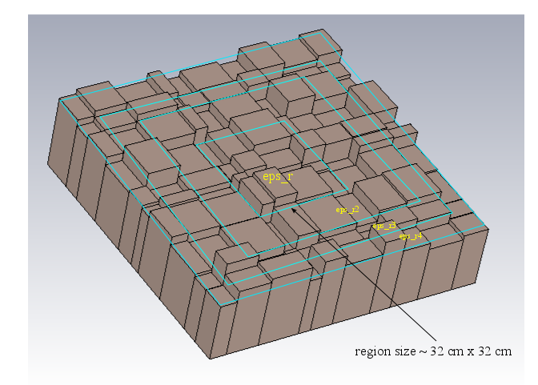
Results with Non-homogeneous soil

Slide 9
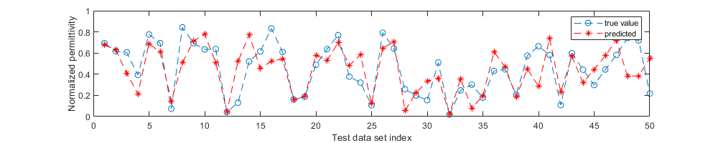
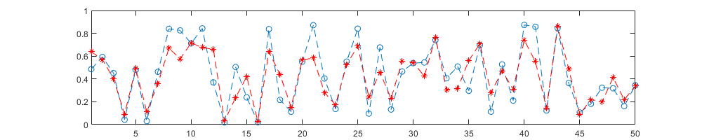
Results with Non-homogeneous soil
Check with different simulation environment
Check with different simulation environment
(2 weeks to obtain
1000 set of data)
It is working! (But with some error). The accuracy may be improved with a lot of more data.

Slide 10
Initial Experiment Results

Slide 11
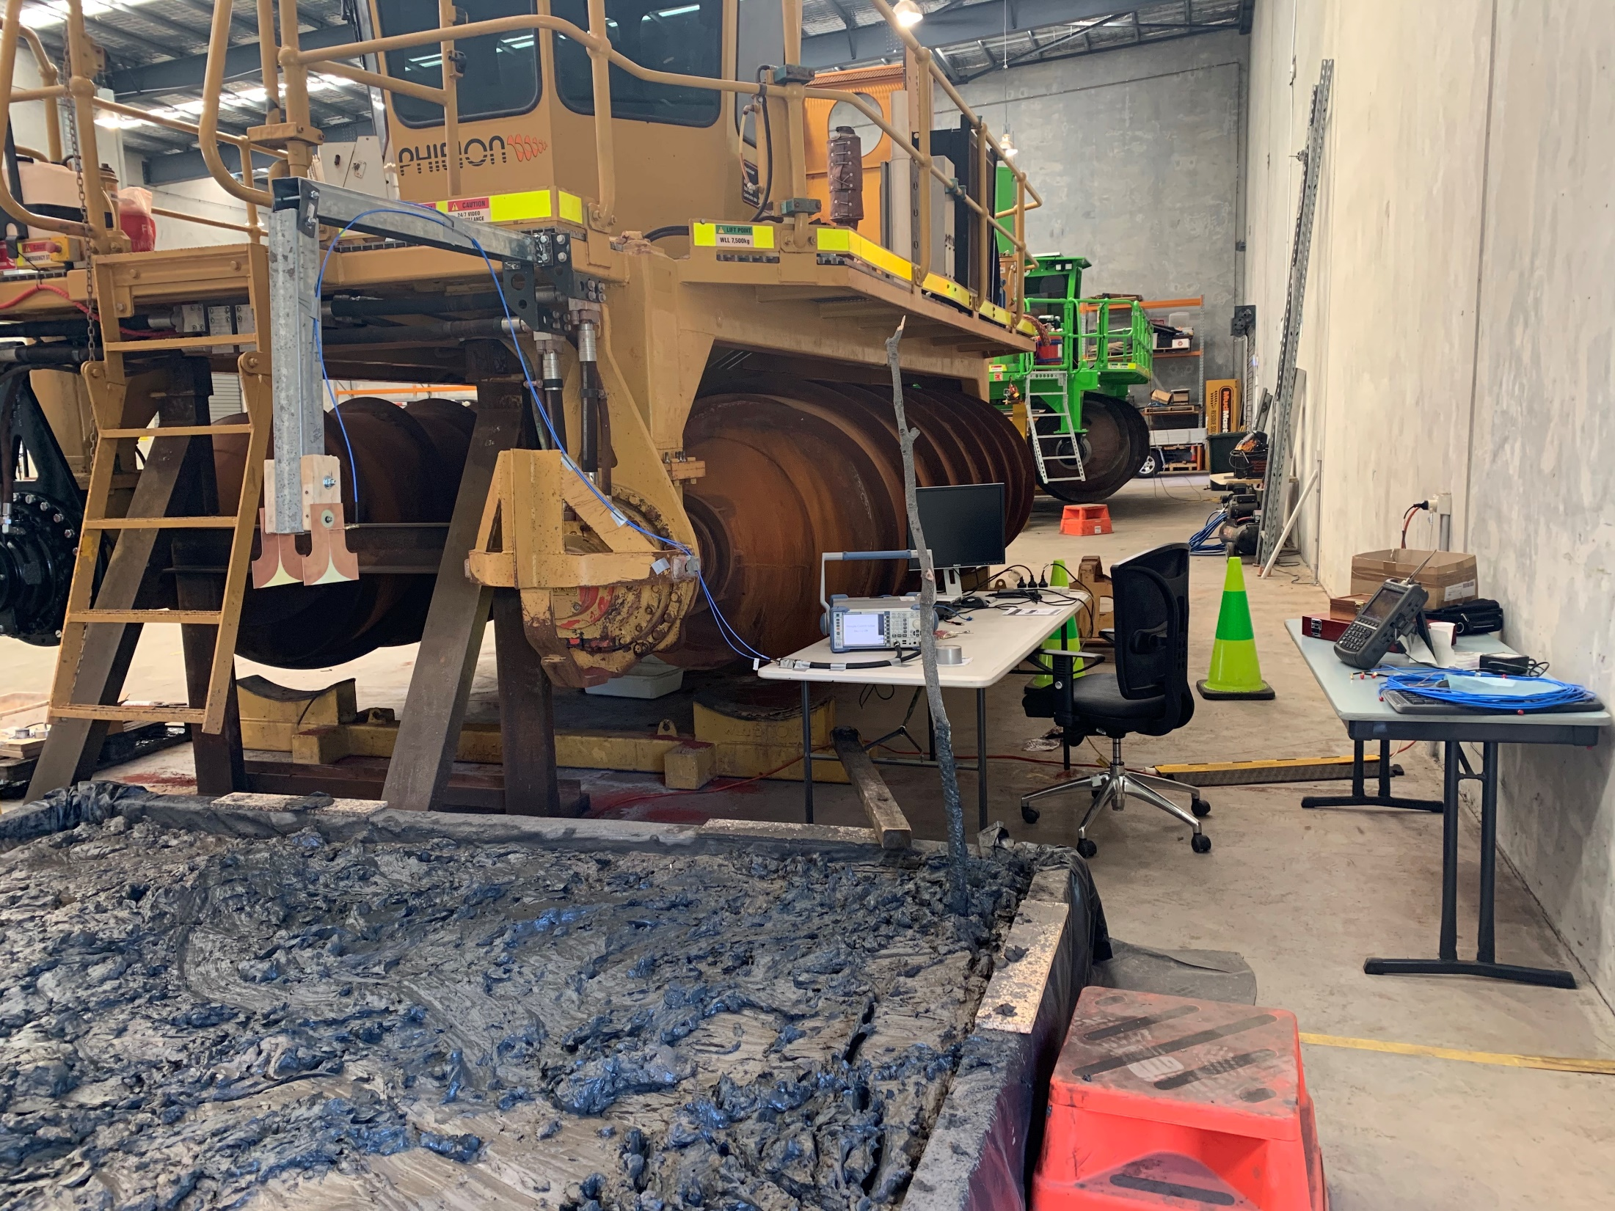
Experimental Setup
Cables are fixed
VNA with automated
measurement
~ 50 cm
Two Vivaldi
antennas
Mud

Slide 12
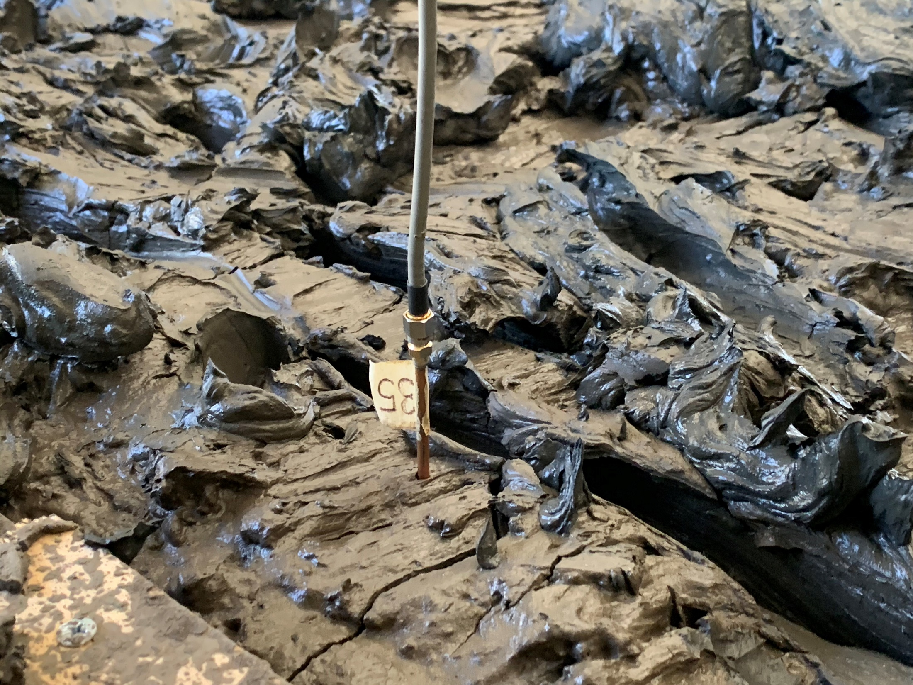
Once time a day, we use a probe to measure the permittivy of the soil at different positions
A soil sample is also stored to measure water content using gravimetric method.

Slide 13
Measured Water Content from Soil Sample
Soil sample is collected (the collecting time is recorded).
The sample is then measured by Sebastian using gravimetric measurements

Slide 14
Since measured data has error (water content cannot increase along the time of experiment),
the water content is estimated by a fitting function.

Slide 15
S-parameter Calibration
In simulation:
subtracts
(without the soil, i.e. the antenna radiates in free-space without any obstacle)
By doing this, we obtain the data that only contains the useful information from the reflection of the soil
(internal reflection of the soil and direct coupling between antenna are removed)

Slide 16
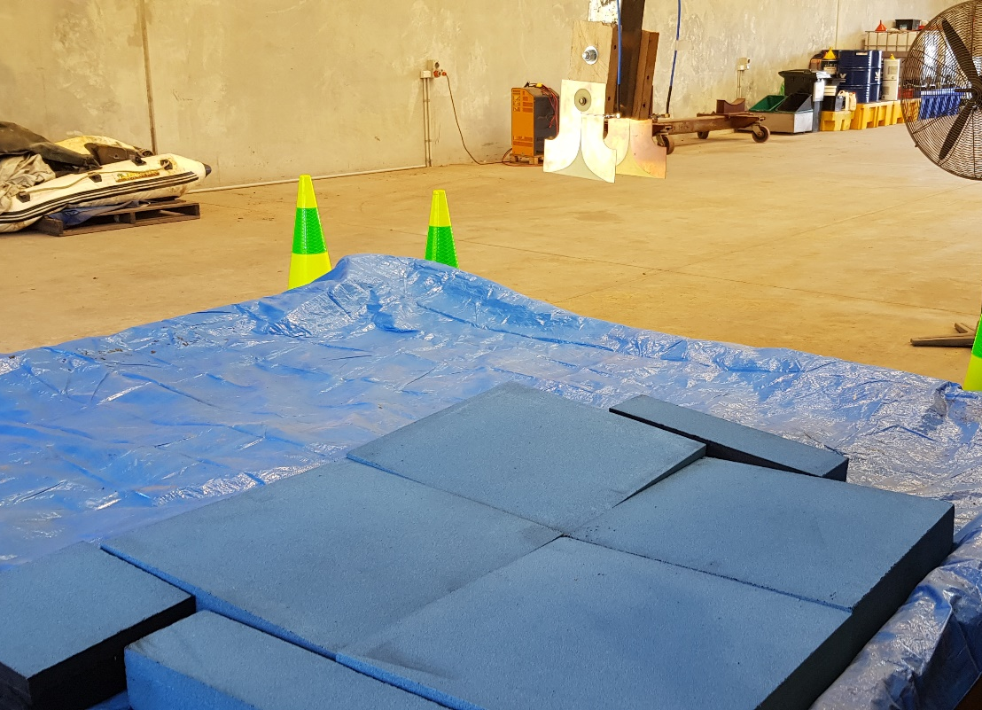
S-parameter Calibration
antennas
antennas
subtracts
absorbers
Using absorber is equivalent to removing the soil
By doing this, we also “calibrate” (or remove) the effects from all other things around, e.g. mud master, cables, etc.

Slide 17
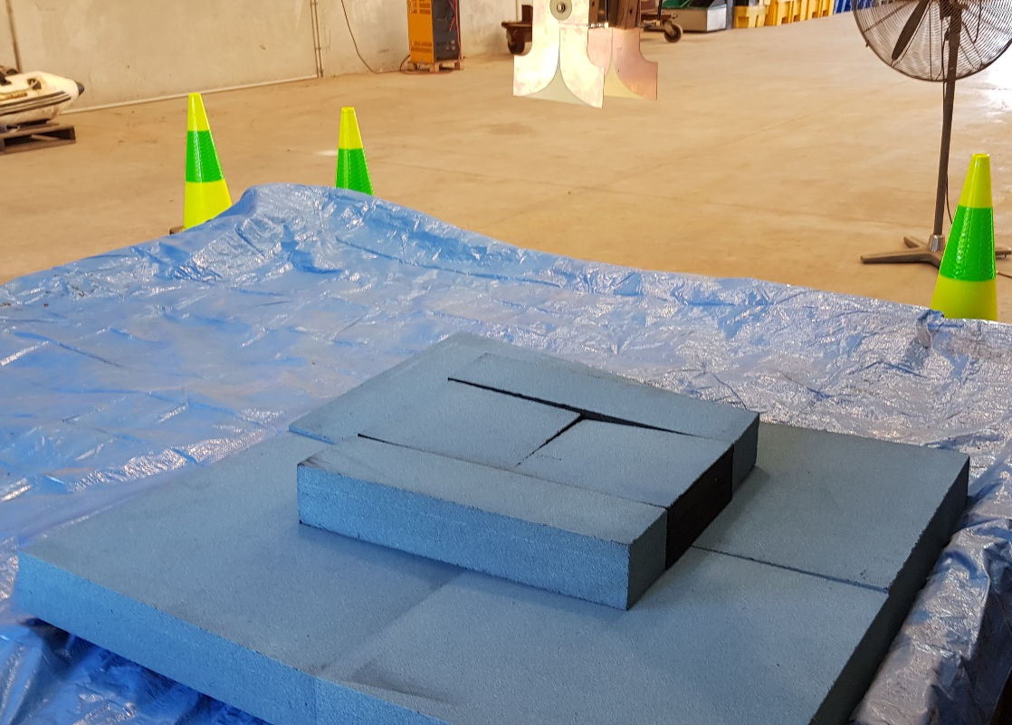
S-parameter Calibration
The calibration is not perfect as:
The absorber is not perfect.
The effect from surrounding environment is complicated with large amount of scattering signals
Two arrangement of absorbers were tried and each of them provides quite different calibrated data

Slide 18
Calibrated S-parameters
Simulation
Measurement

Slide 19
Neural Network
Calibrated data is separated into two sets of data: training set and testing set.
Data is collected from 20/07 to 06/08 with 1419 set of data. Along this time, we keep changing the surface of the soil.
As water content is gradually decreases along the time, for the first test, the predicted quantity, or the output (y), is the time at which the data is collected

Slide 20
Training Data
Testing Data
Average Error: 1e-5 (extremely accurate)

Slide 21
Test on Data with different Calibrations.
Average error: 0.023
Average error: 0.075
Can be corrected by scaling factor

Slide 22
Combine all set of data with different calibrations
Total set of data before: 1619
Total set of data after combining: 3*1619 = 4857
Training Set
Testing Set
Average Error: 1e-4 (extremely accurate)
-> This Neural Network is much more robust to the error in calibration

